Slide 1


ENERGY & ENVIRONMENTAL SOLUTIONS

Slide 2
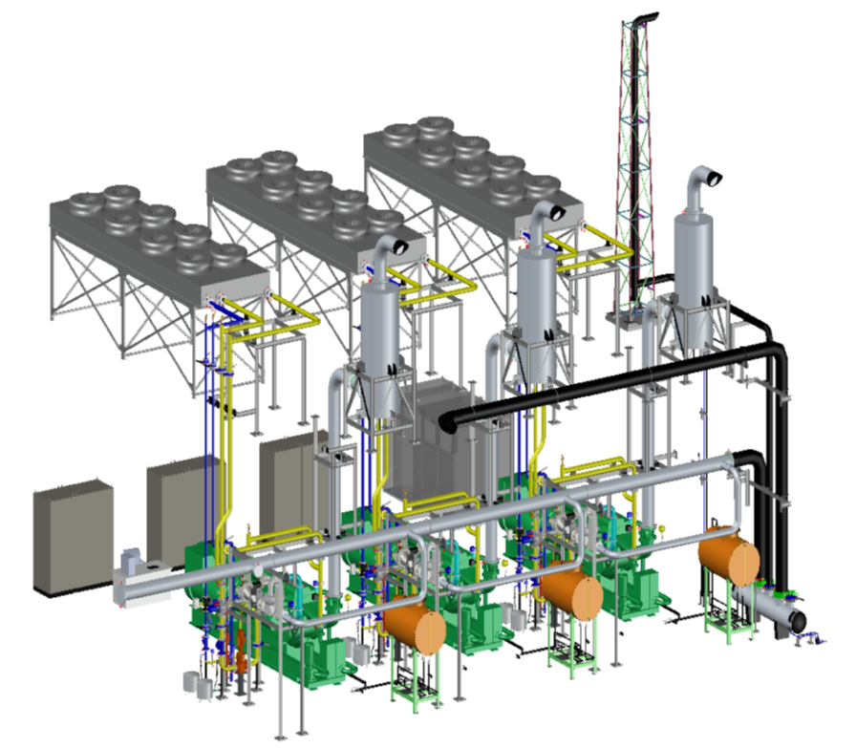
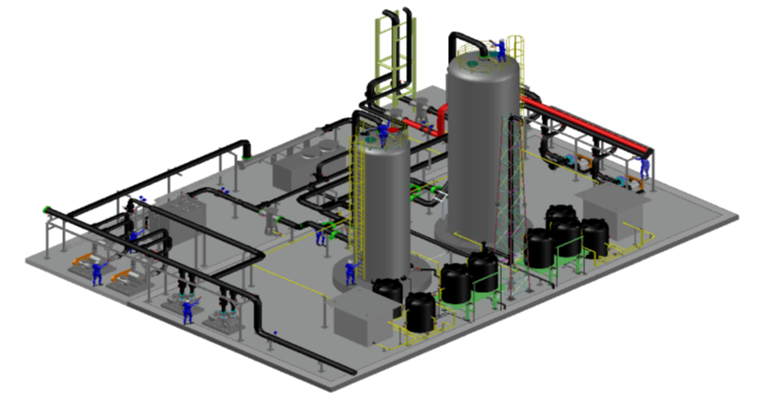
Creative Energy Solutions
are our Competence

Slide 3
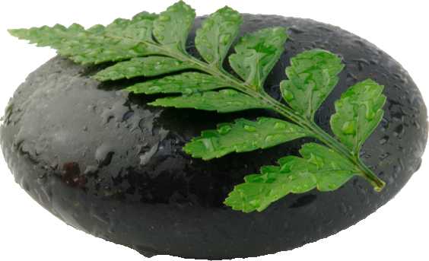
Introduction & Mission
Established in 2004 Retech Energy focuses on Project Development and the Supply of Technology and Equipment for the Energy and Environmental Industries
Together with a network of accredited technology partners Retech Energy offers professional support and services
One of the main targets is to combine imported and local supply in order to stay within budget expectations of clients without compromising quality, performance and safety

Slide 4
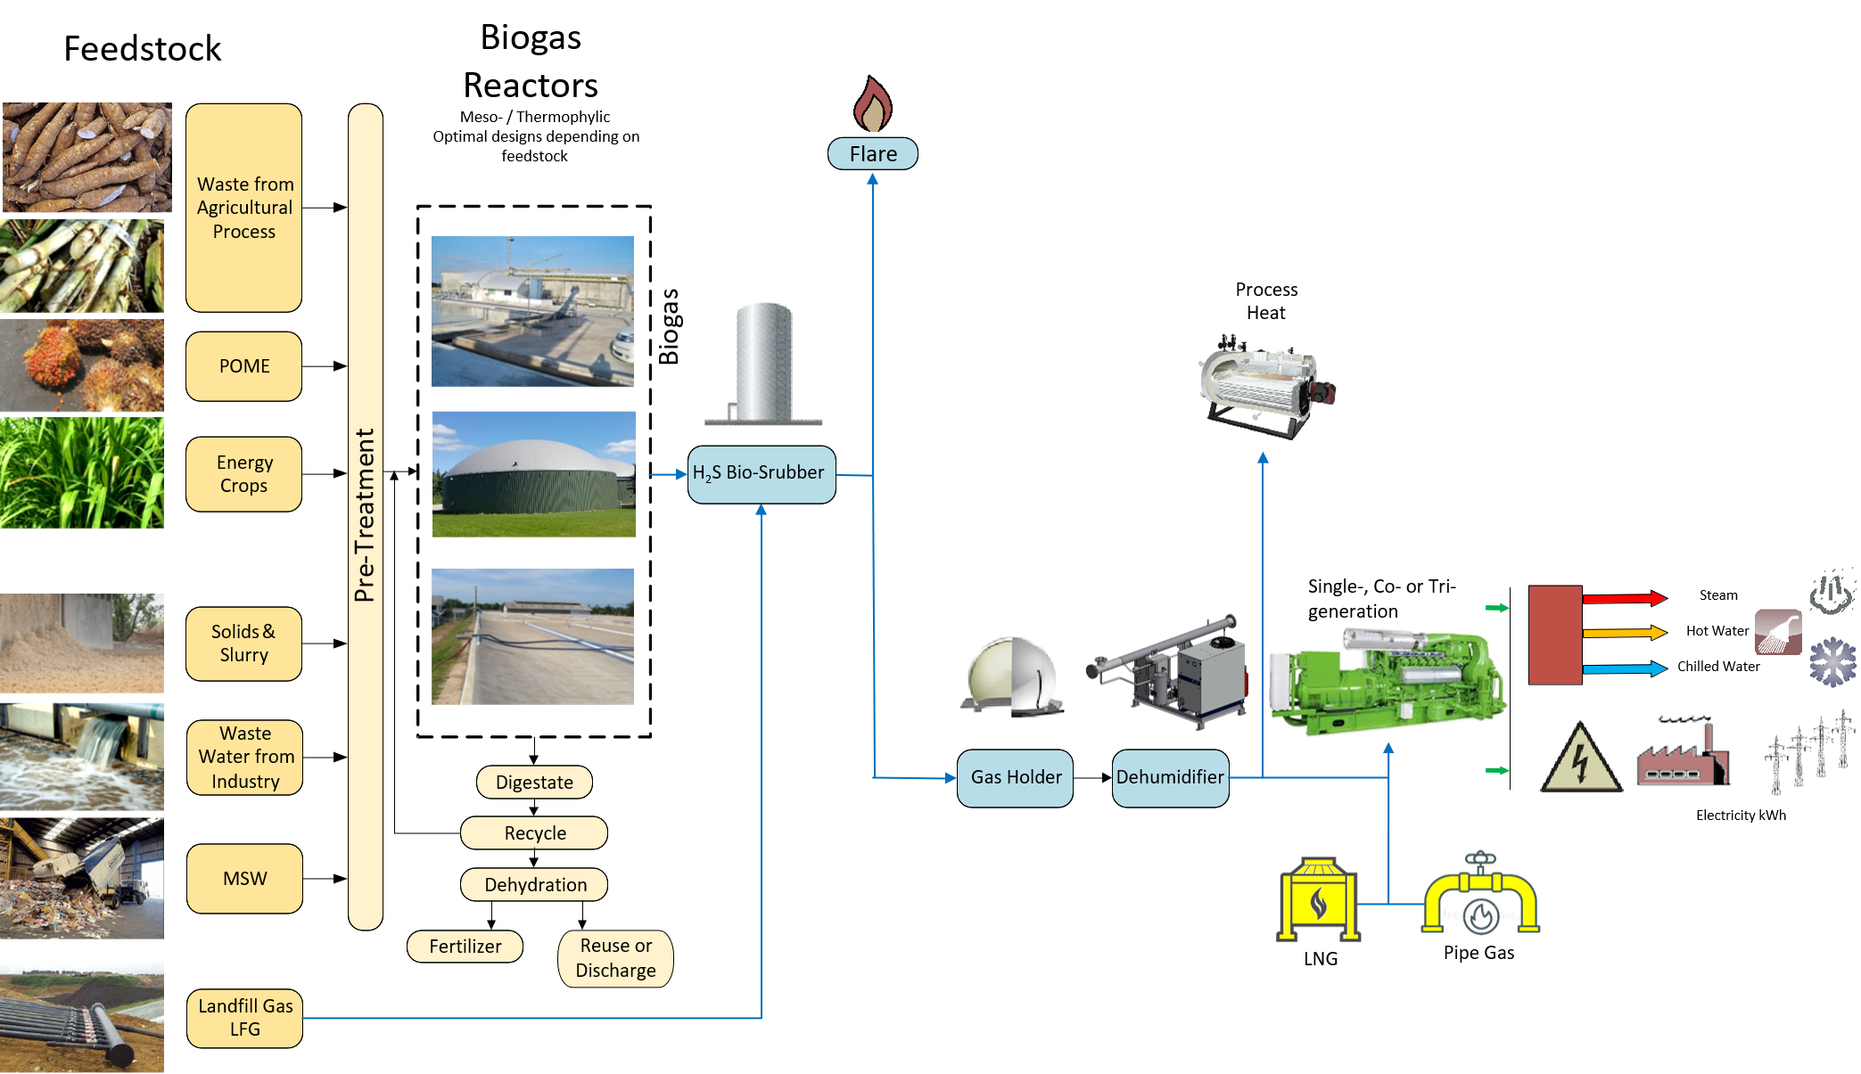
Production & Utilization of Biogas and Natural Gas

Slide 5
Biogas Systems
Turn-Key Projects for the following industries
Food Processing
Beverage
Starch Plants (WW &Pulp)
Palm Oil Mills (POME, FilterCake, EFB
Ethanol (Mollases & Cassava)
Energy Crops (i.e. Napier Grass)

Slide 6
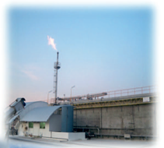
Biogas Technology
Lagoon 4.0 Mixed Lagoon with flat floating roof and complete mixing
CSTR technology Accepts a wide range of feedstocks, meso-and thermophilic
UASB technology for easy to digest waste waters
Containerized reactor for small throughputs
Plant Control System iCoSy to reach high level of automation
Remote Controlling and Monitoring as well as biological support
Biogas Laboratory in Thailand and Gas Yield Testing

Slide 7
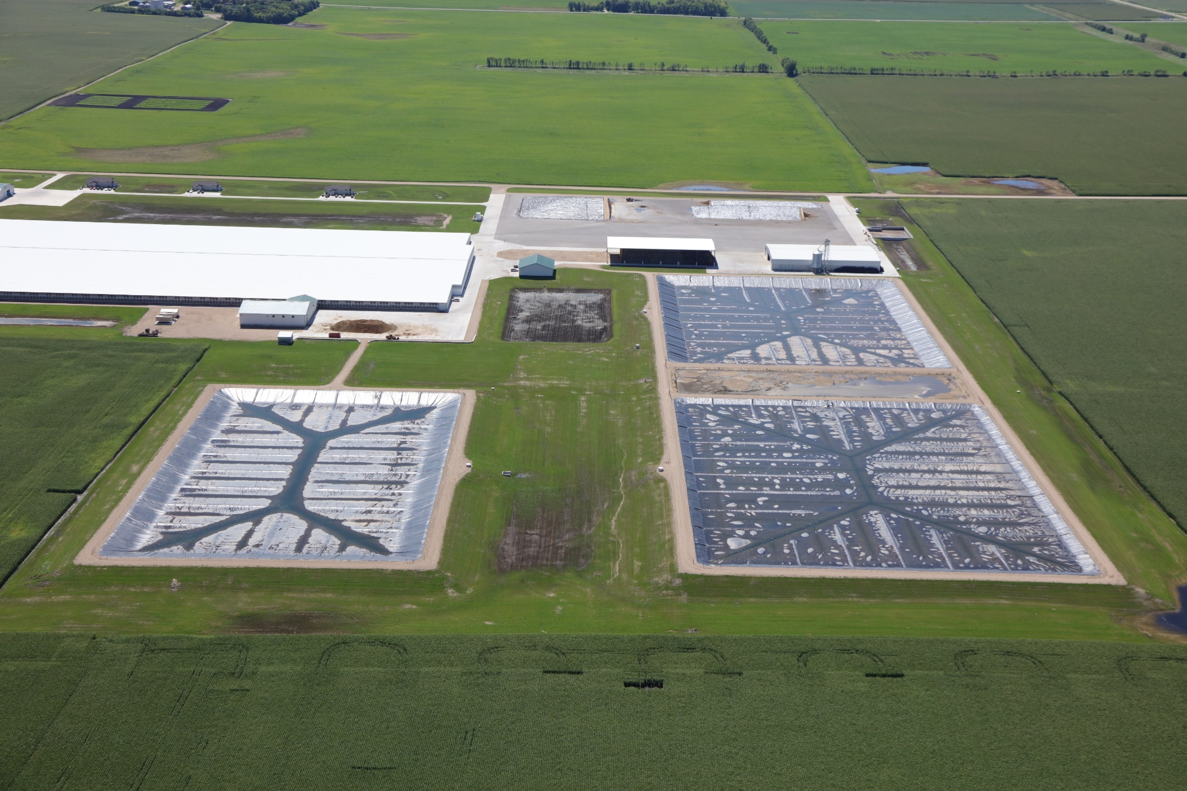
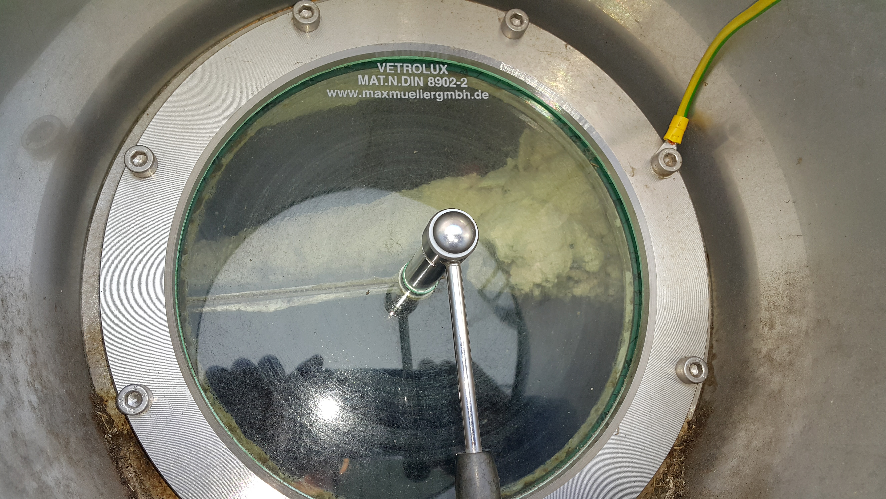
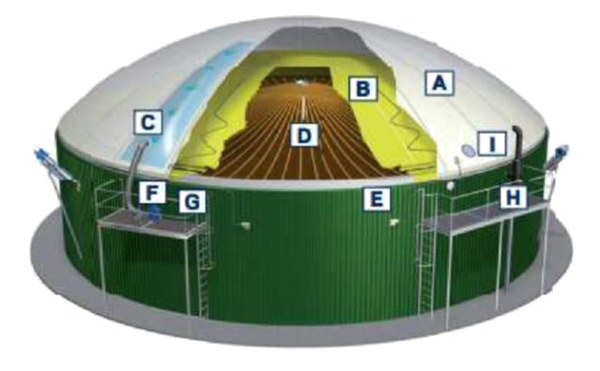
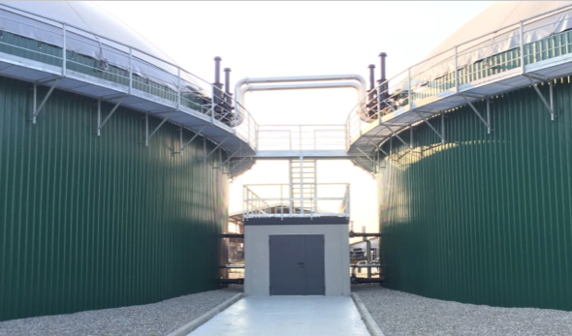
Industries still depend to a large extend on imported fossil fuels and grid power
Renewable Energy is readily available from process waste and by-products such as organic loaded wastewater streams and solids
They typically originate from agriculture based industries such as cassava, palm oil, sugar cane and ethanol as well as from the food and beverage industries.
Digestion of Organic loaded Waste Water & Solids, Energy Crops
Desulphurization (Scrubbers)
Gas Engine Generators
Biogas Purification Systems (Upgrading)
Gas Storage
Optimization of existing Biogas Plants
Digestate Post-treatment & Effluent

Slide 8
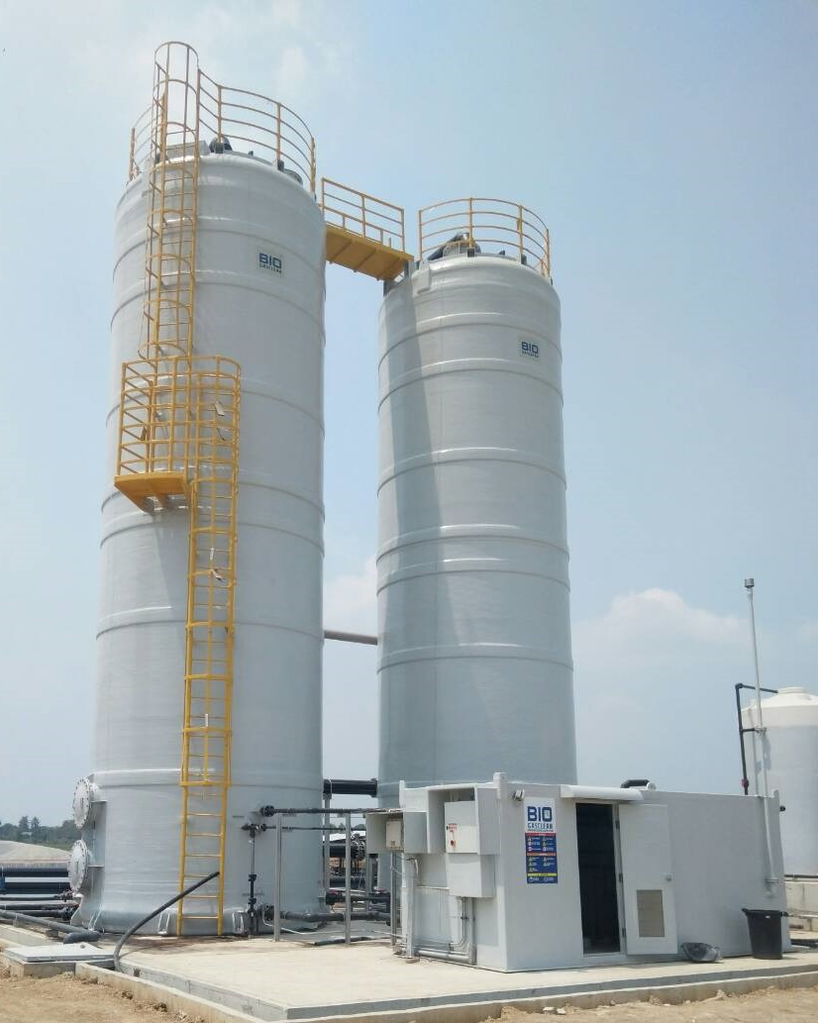
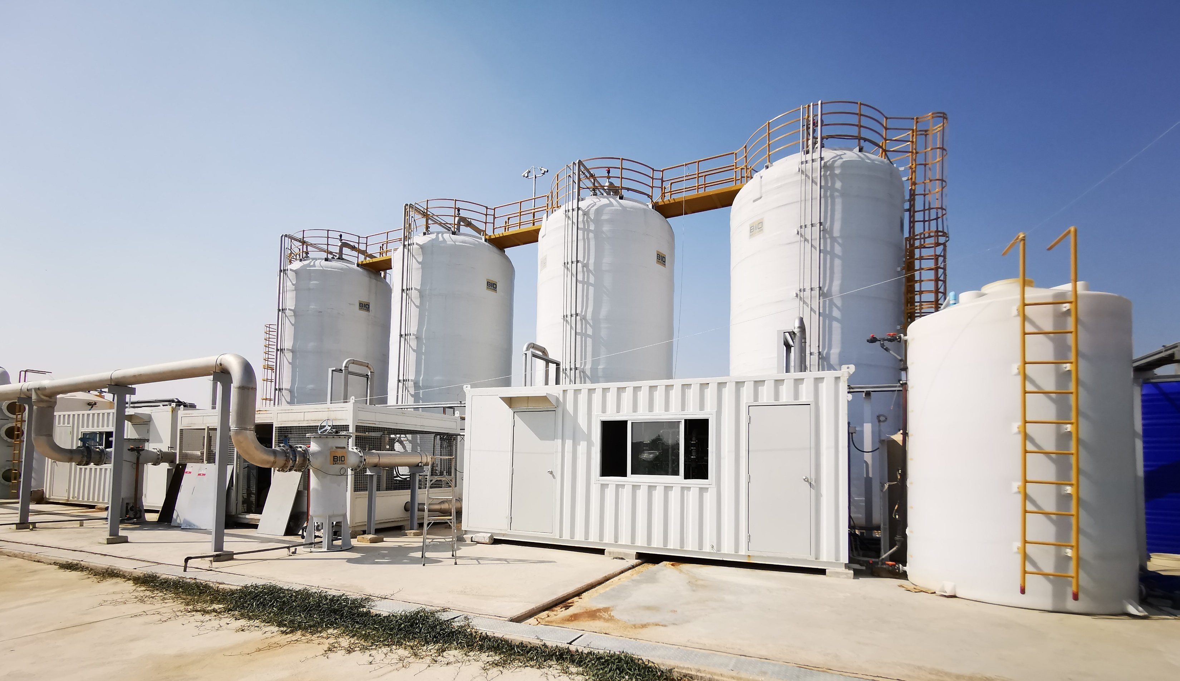
Biological H2S Scrubbers
The content of H2S in the raw biogas depends on both the organic substrate and the preceding production process.
Typically, the H2S will be in a range from 0,1% to 3% (1.000-30.000 ppm).
During combustion the H2S will convert into SO2 and when in contact with moisture forms sulphuric acid (H2SO4) which will lead to severe corrosion of gas engines, burners and auxiliary equipment as well as air polluting emissions (SOx).
Avoid reduction of engine’s lifetime.
Reduces revenue from power sales due to overhauls and break downs.
Avoid expenses for repairs and frequent oil changes as well as for spare parts.
Retech Energy offers a full range of biological H2S scrubbers: from small gas cleaners to large systems for very high H2S concentration.
A new MBR (Moving Bed Reactor) type Scrubber has been added to the program and is already in successful operation. The MBR system has been developed especially for molasses based distillery waste waters with high (>10.000 ppm) H2S content.

Slide 9
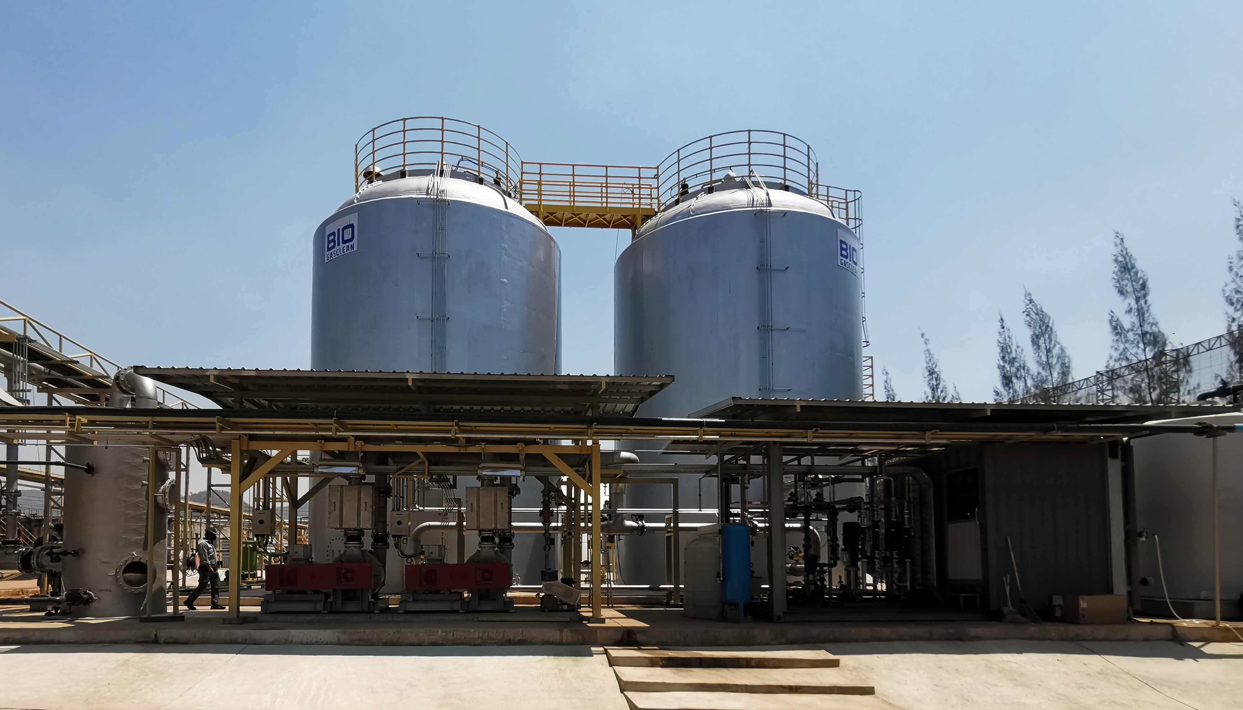
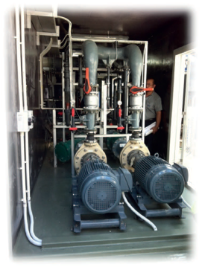
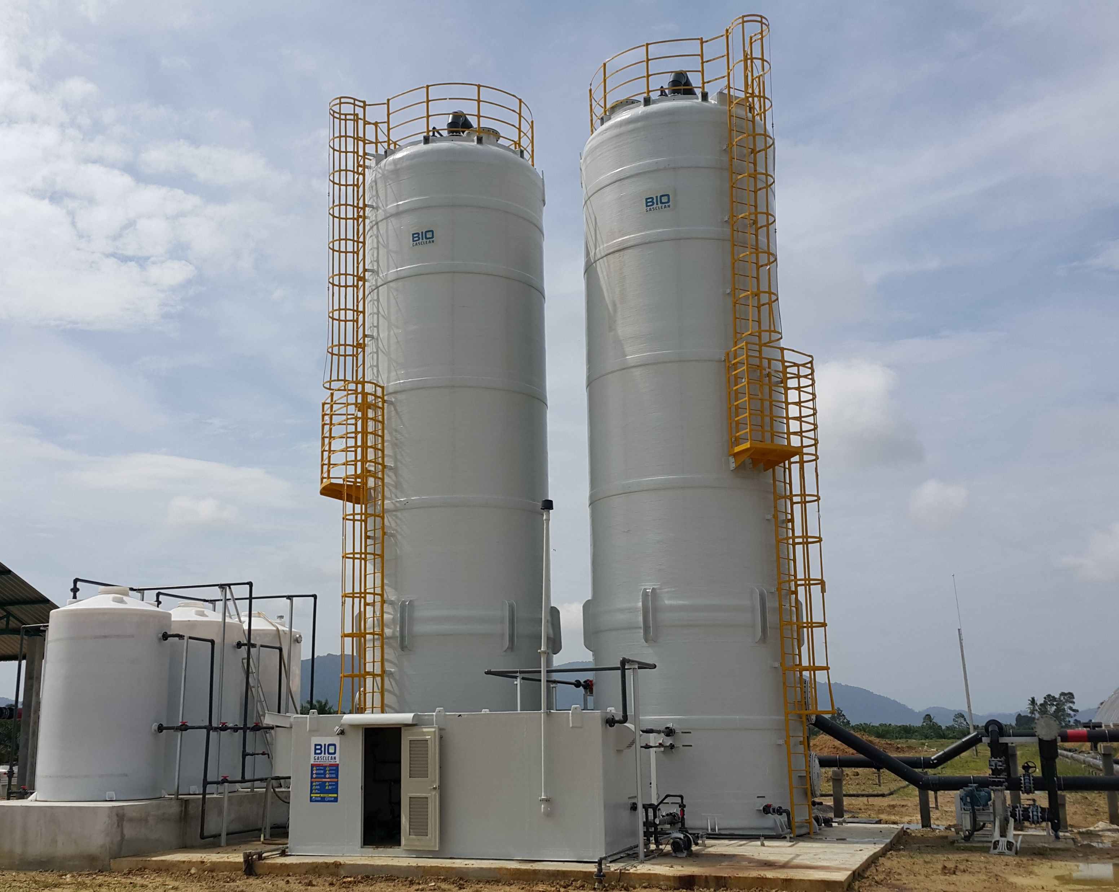
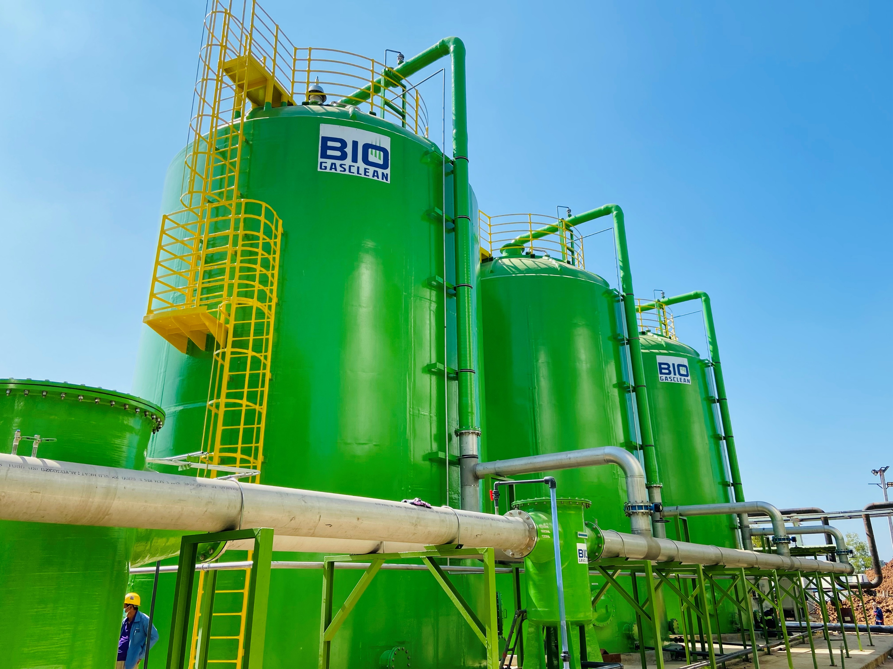
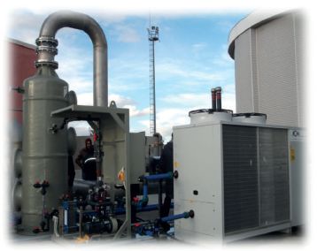
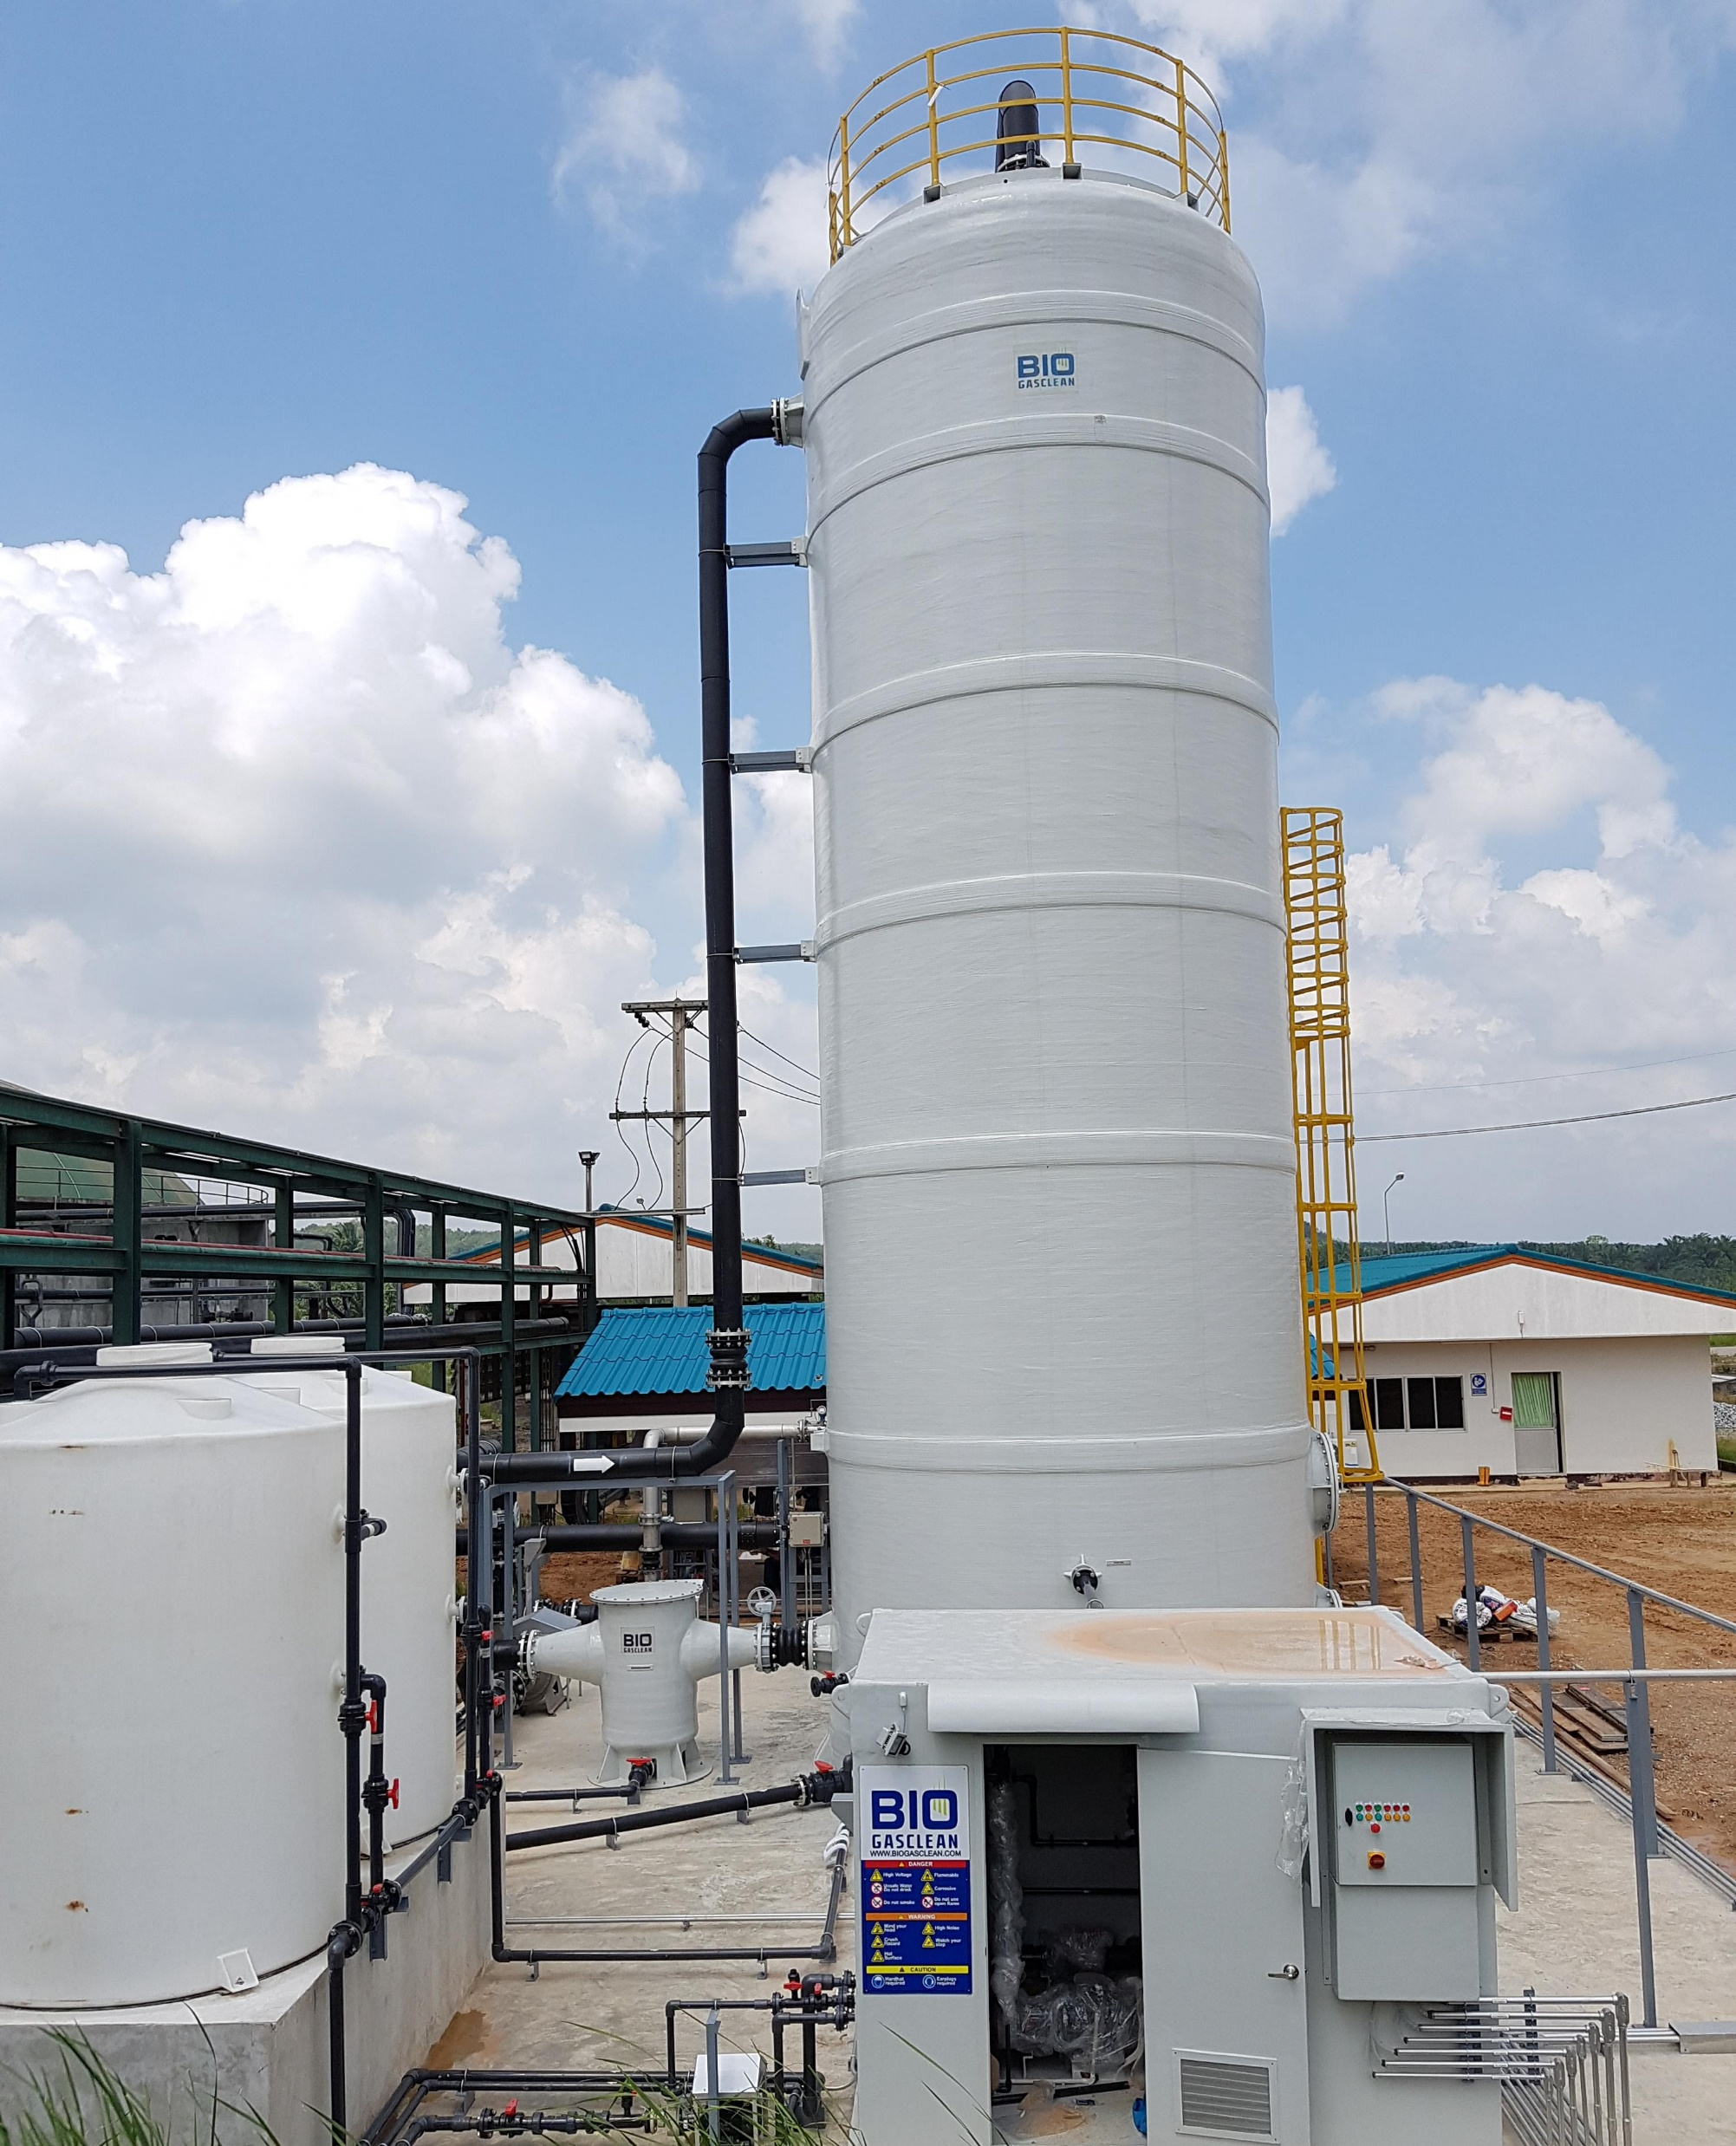
H2S Desulphurization (Scrubber) & Gas Dryer

Slide 10
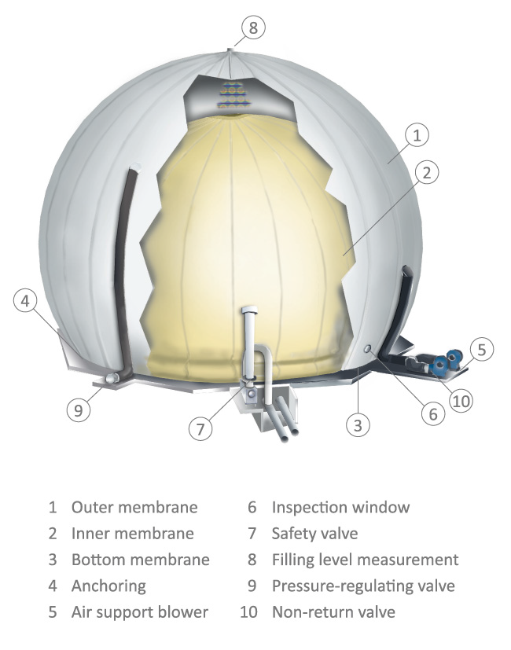
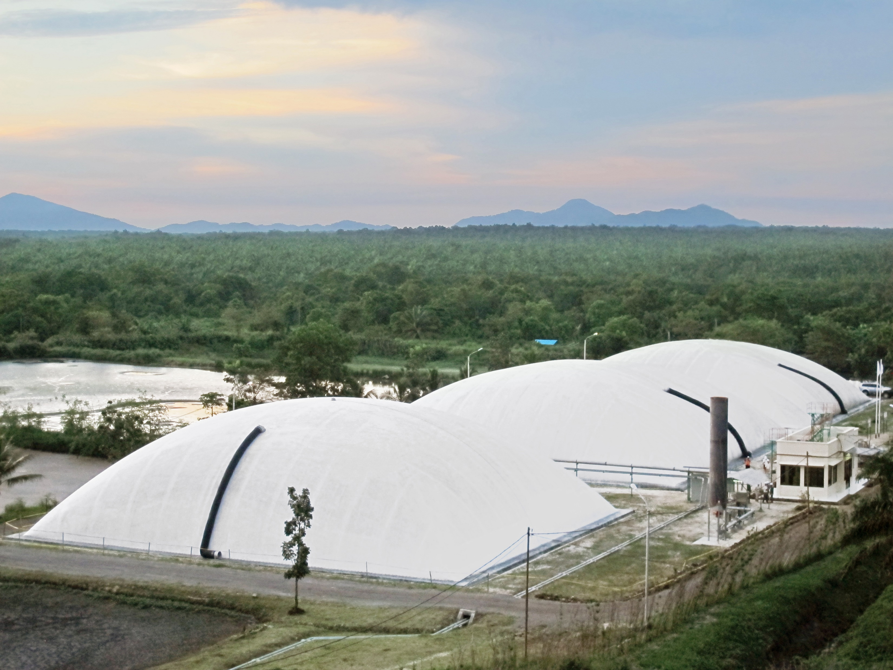
Biogas Storage Systems and Digester roofs
High quality materials
Long lifetime
Double Membrane
Fast delivery and quick installation

Slide 11
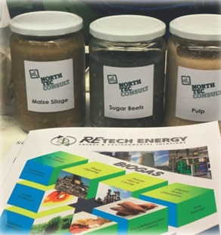
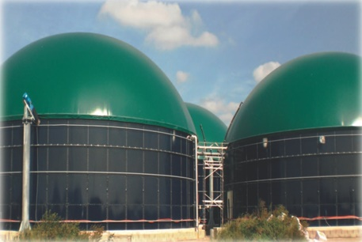
Repowering and Optimizing existing Biogas Plants
Plants which have been in operation already for some time, not always deliver the results as expected.
Most common reasons:
outdated design
unsuitable construction materials
too many manual operations
change of your manufacturing process
wrong design right from the beginning.
Needless to say that existing equipment will be maintained to the maximum possible extent.

Slide 12
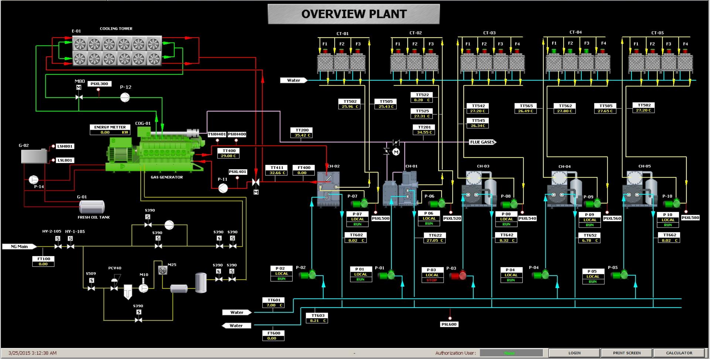
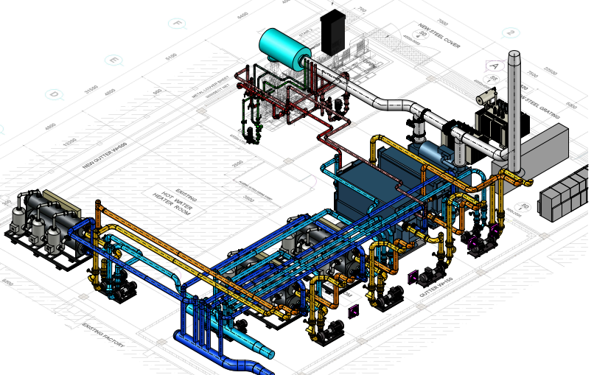
Cogeneration
An Investment that pays off
A Combined Heat and Power (CHP) plant simultaneously generates electrical and thermal energy.
A CHP plant has an overall very high energy efficiency
A CHP plant increases competivness in production processes
Tailor-made solutions based on various fuels such as Natural Gas and Biogas.
Retech Energy offers such solutions for either greenfield projects or as integration into an operating plant

Slide 13
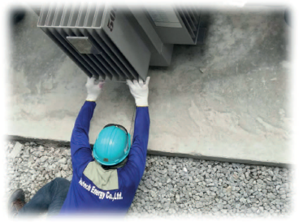
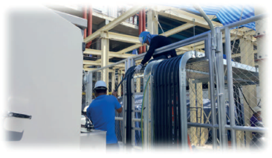
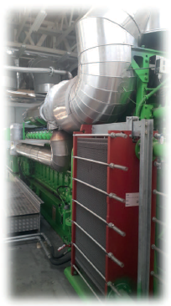
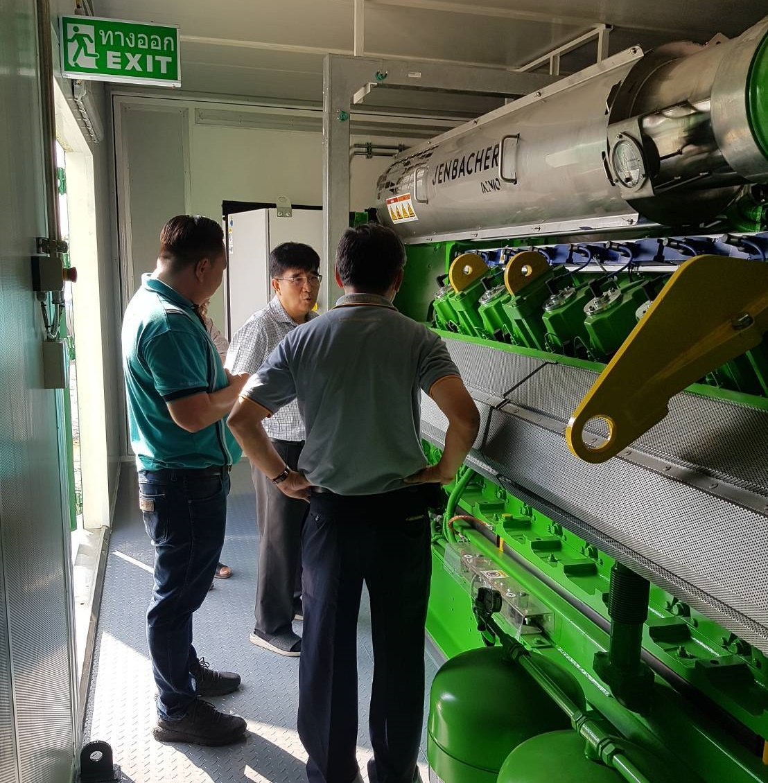
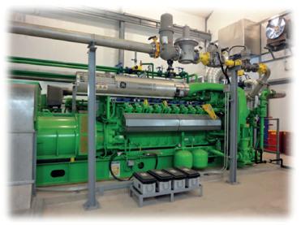
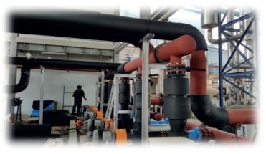
Some References in Pictures

Slide 14

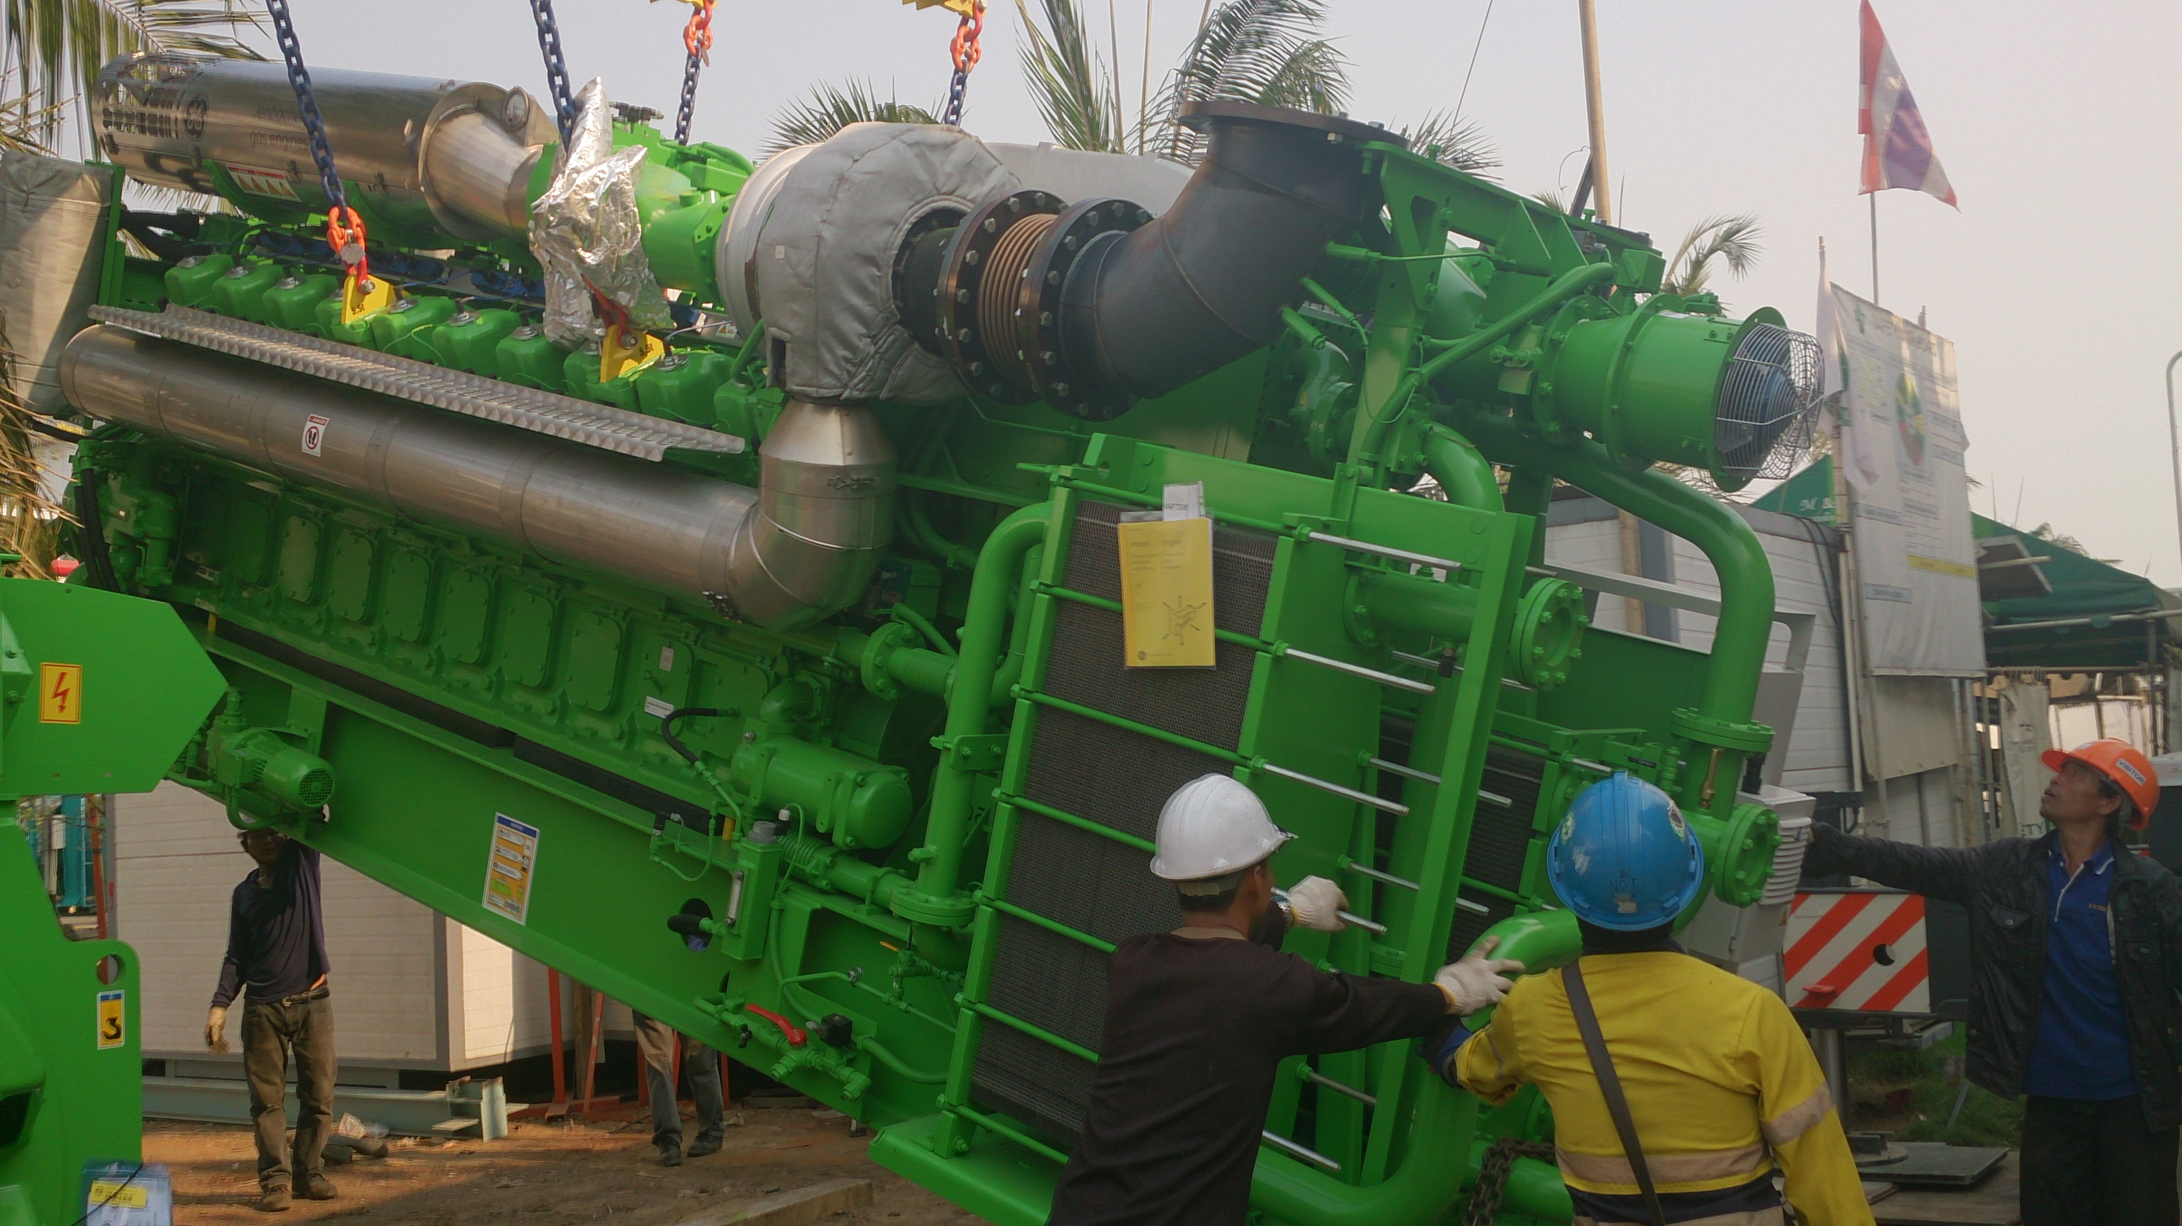
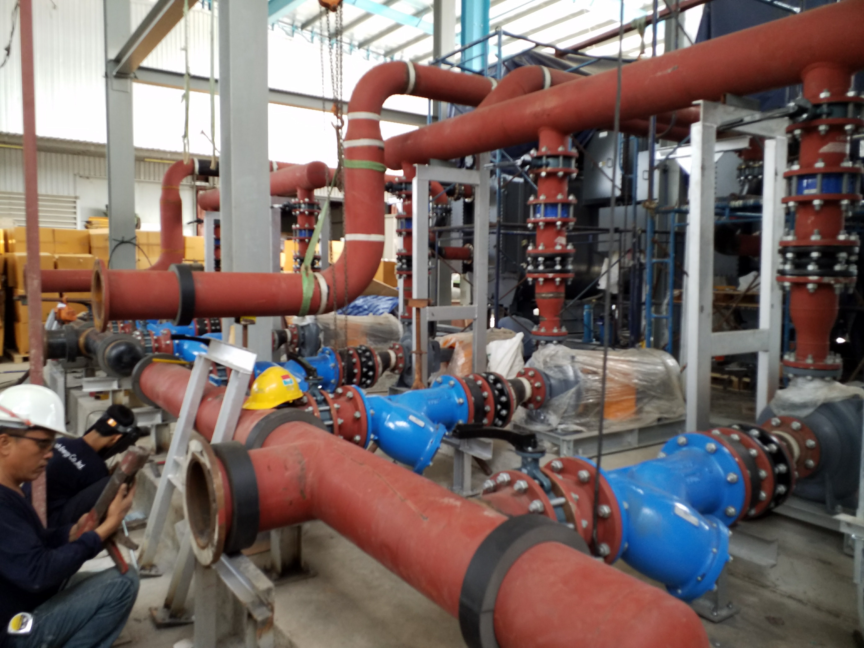
Balance of Plant (BOP)
Retech Energy can provide Balance of Plant equipment and installations to ensure a most efficient and functioning system for both Natural Gas or Biogas fueled plants.
Balance of Plant (BOP) scopes typically include:
Layout & Design of components
Installation of equipment
Heat recovery systems (hot water, steam, chilled water)
Electrical systems (Switchgear, transformer, Plant Monitoring System, Scada
Grid connection

Slide 15
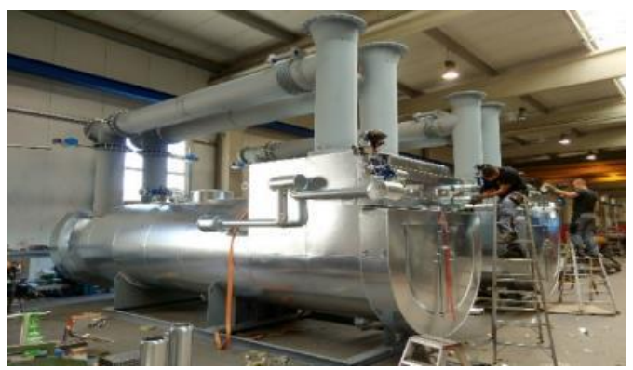
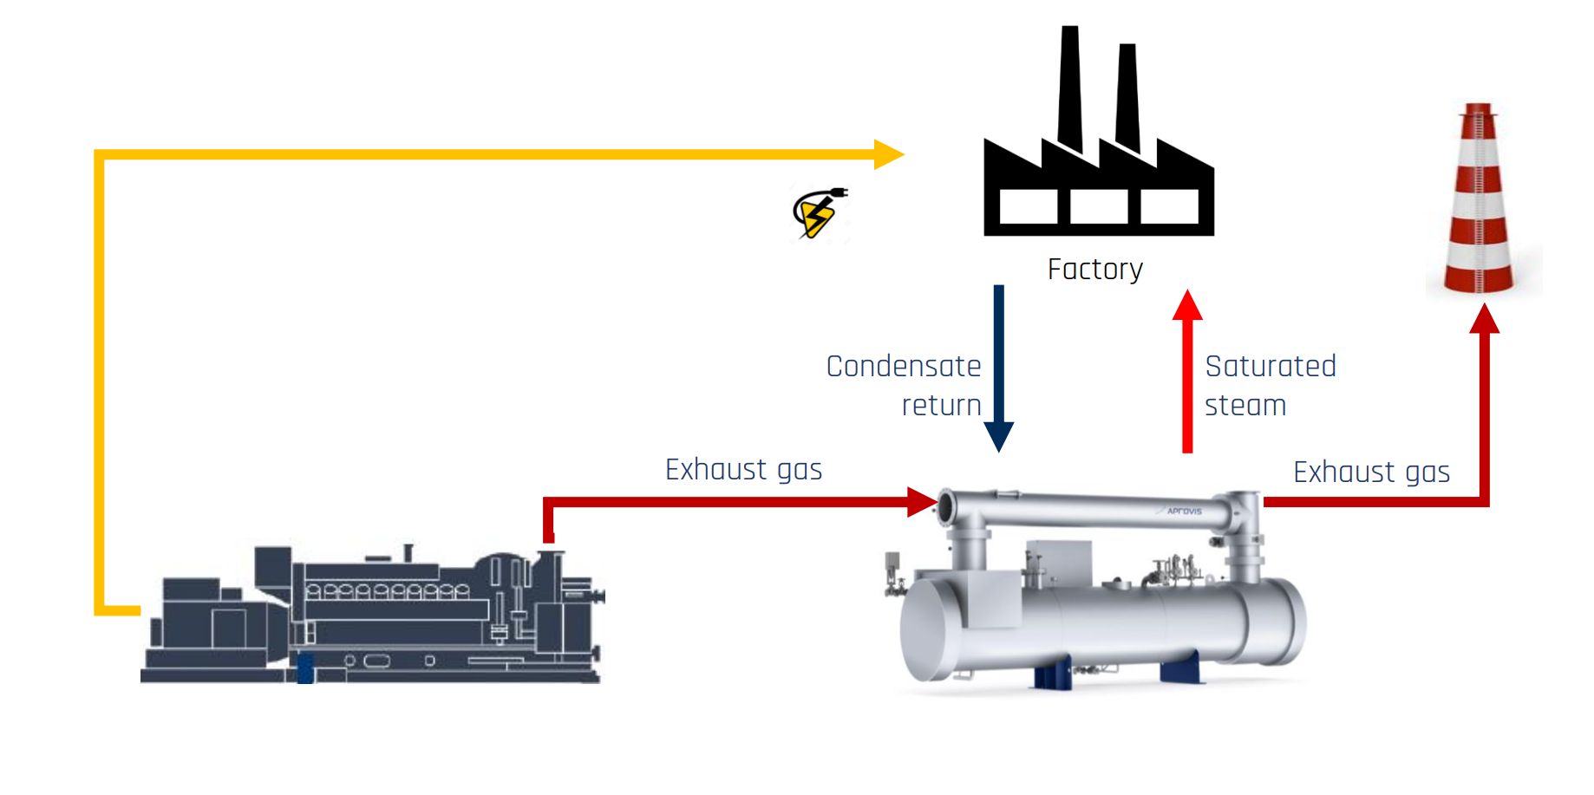
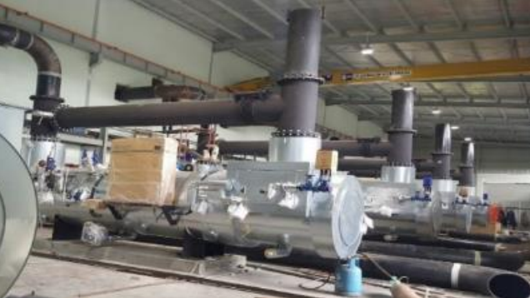
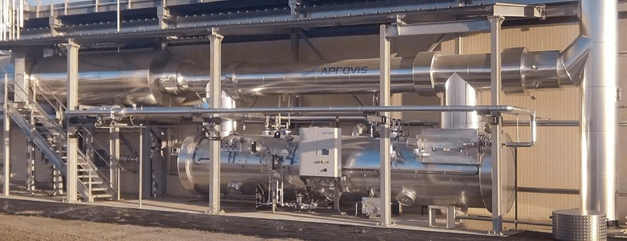
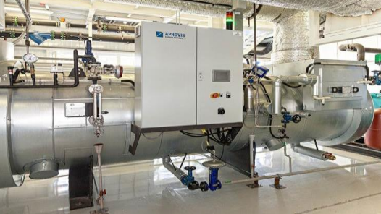
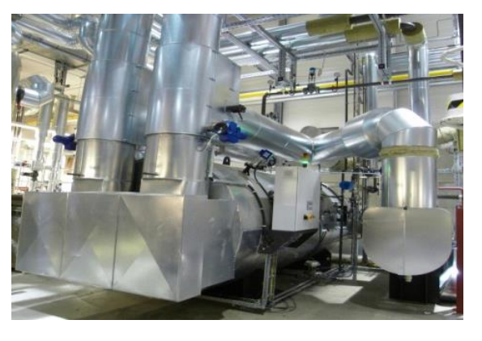
Waste Heat Recovery Boiler
Connects up to three engines
Feeding to Absorption Chiller
Feeding to steam header for process heat

Slide 16

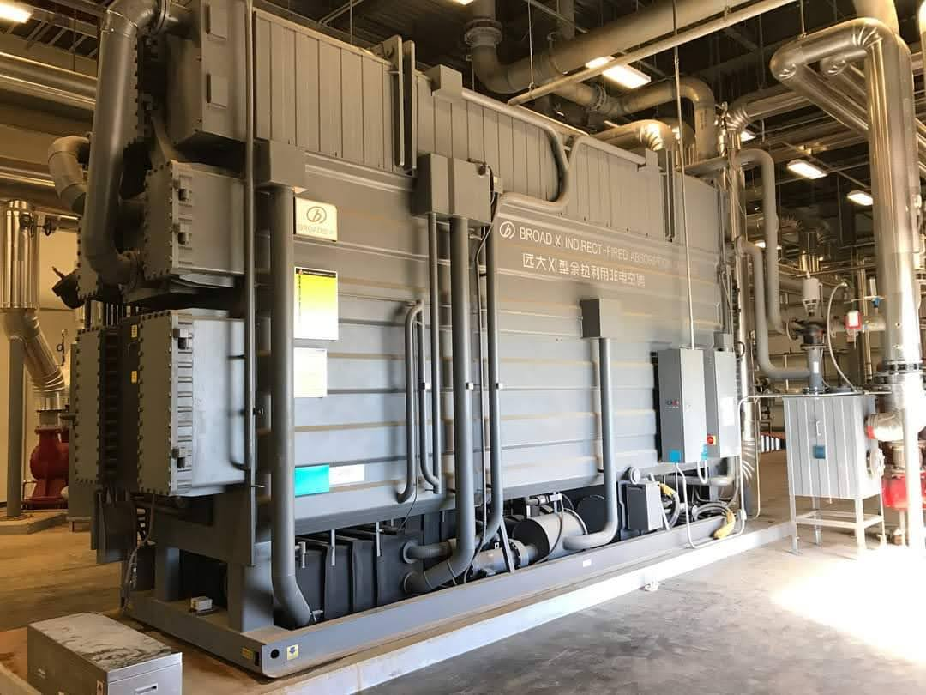
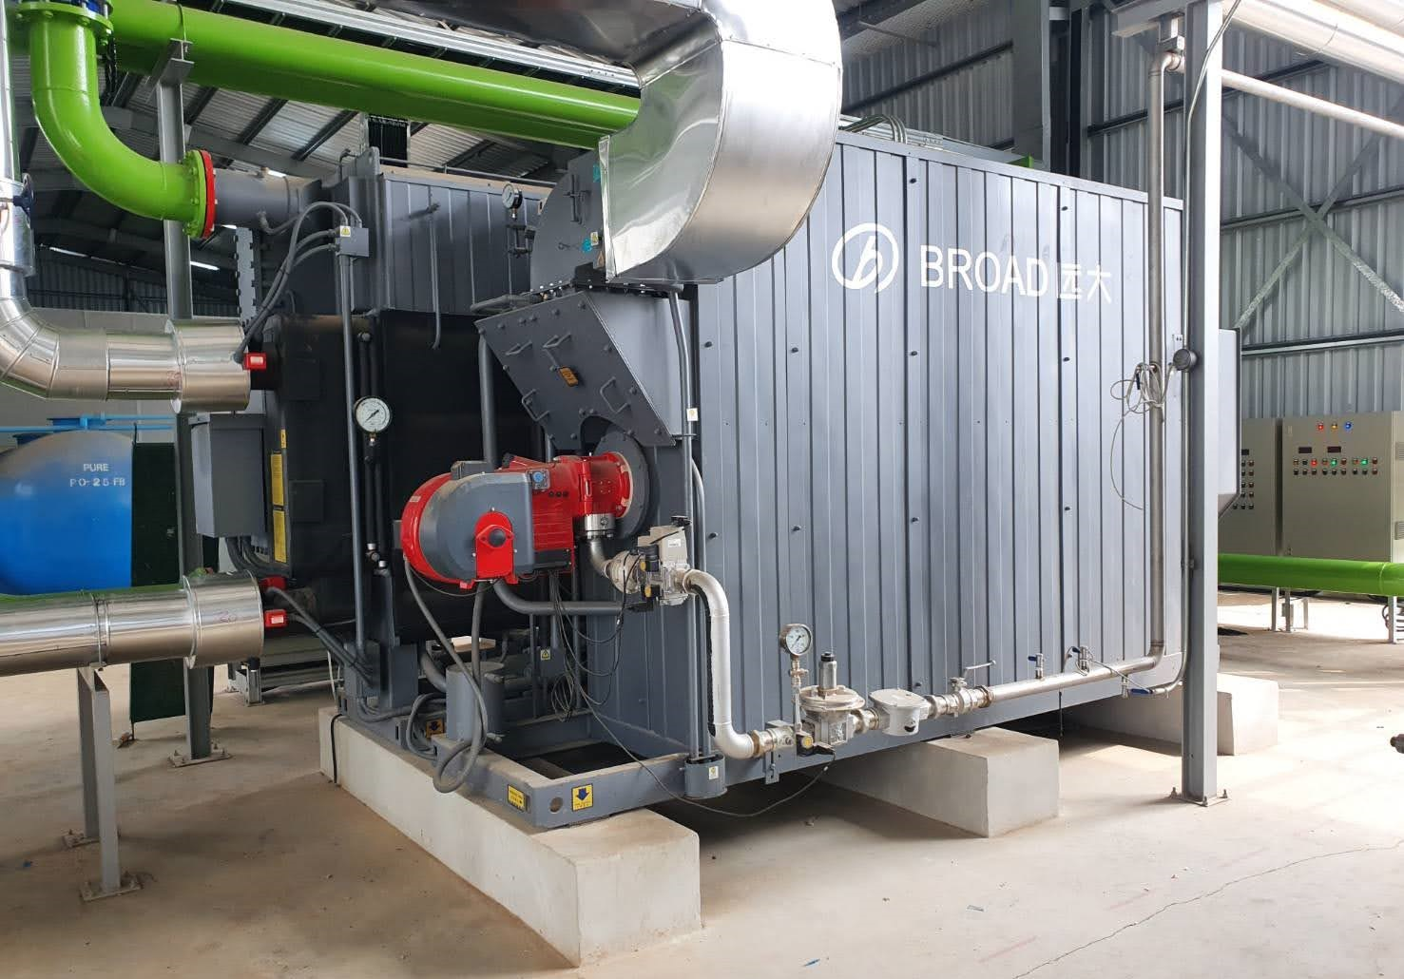
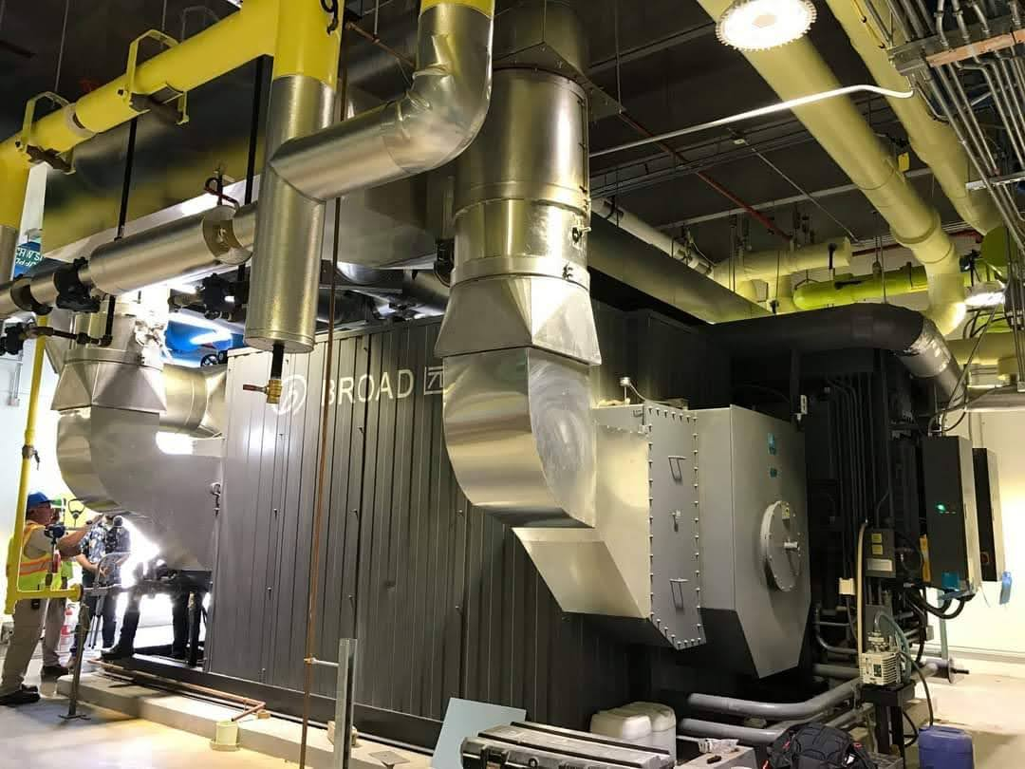
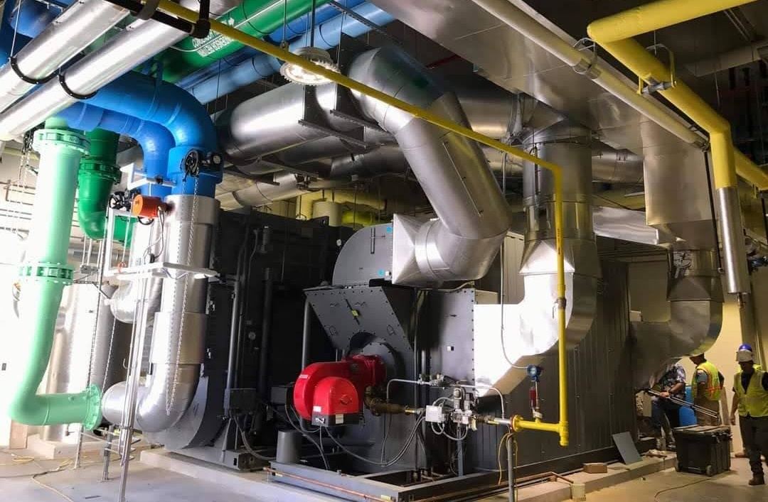
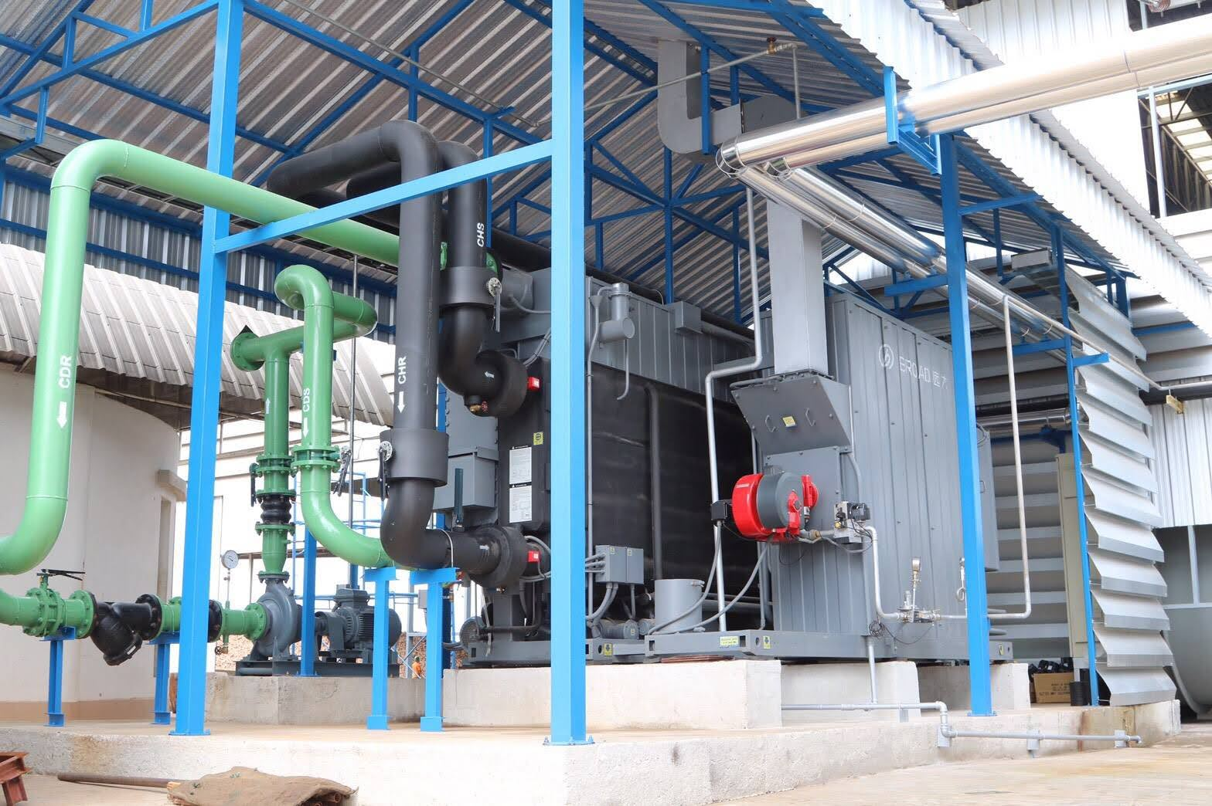
Absorption Chiller
Can be supplied as Multi Energy Chiller
Can be direct fired
Supplies chilled water for process
Can be utilized for Air Con System
Includes pump set and cooling tower

Slide 17
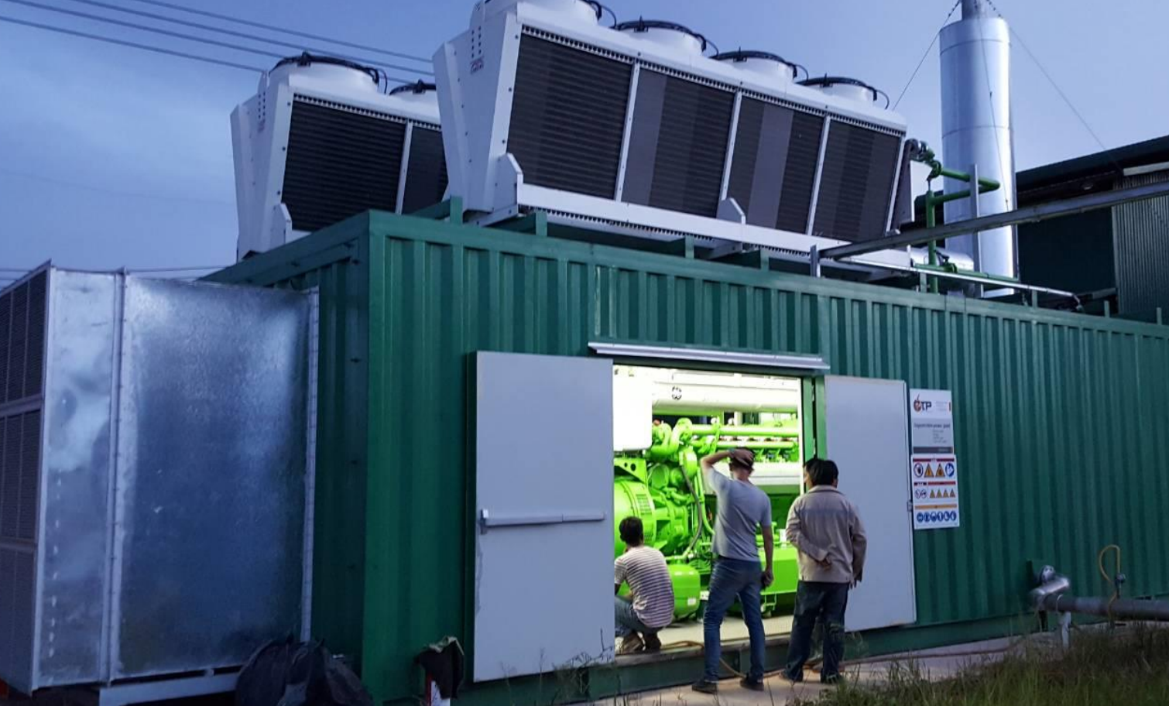
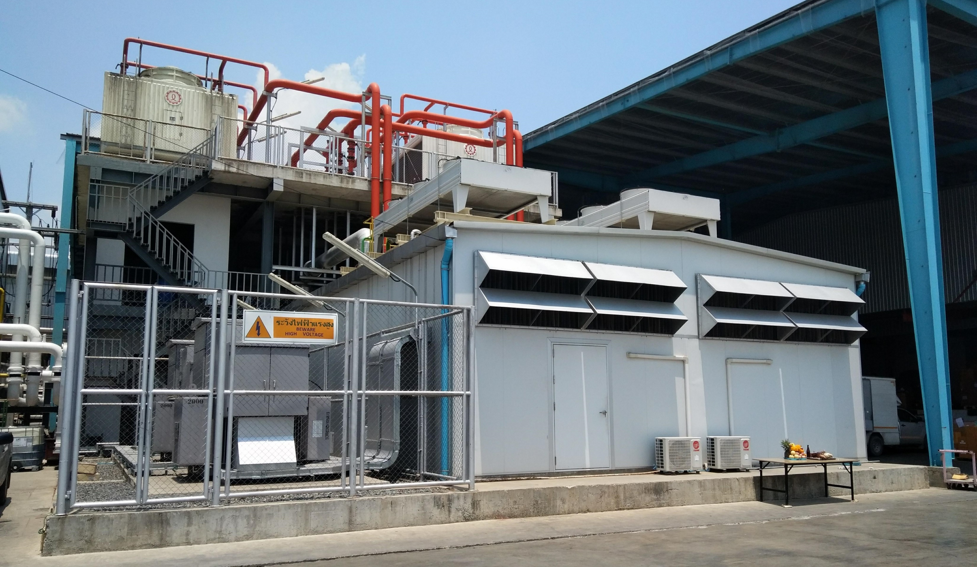
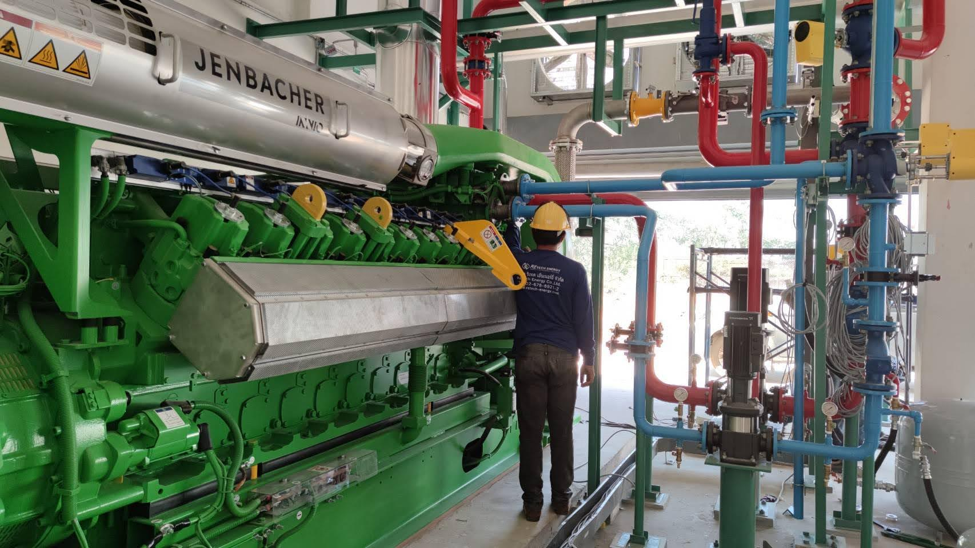
Gas Engine Generators
Retech Energy integrates gas engine generators into their biogas projects. Such installations suggest either
power house options,
containerized packaged units or
simple enclosures
recovering generated Heat from the engines. (CHP)

Slide 18
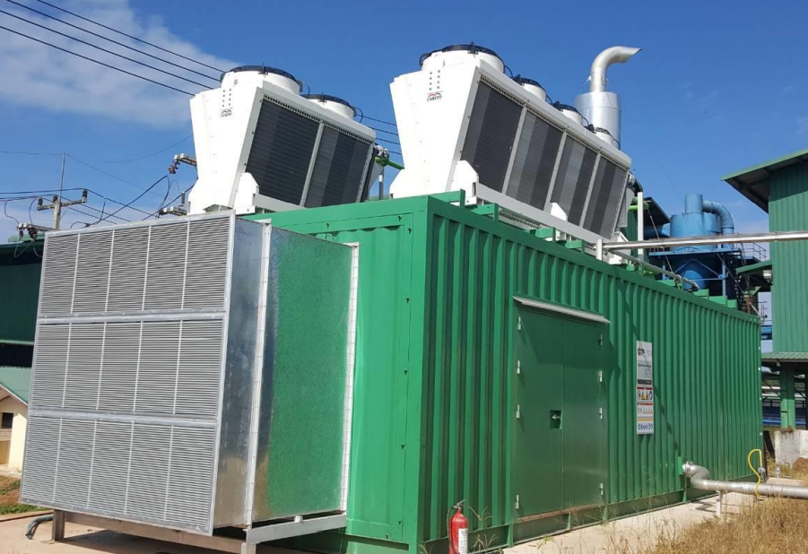
PowerBox
The perfect housing for your Gen-Set
Retech Energy has developed a perfect Gen-Set housing system as an either stationary enclosure concept (PowerBox-E) or a mobile container concept (PowerBox-C)
Advantages of the PowerBox concept:
Modular & Expandable Construction suitable for any engine brand
Heat and soundproof sandwich panels for outer shell
Comfortable space around the engine for maintenance & service
Integrated professional air venting system
Separate air-conditioned control room
Suitable for co-and trigeneration systems
Pre-engineered connection to gas train and transformer
Sufficient door sizing for easy installation and exchange of engine and components
Pre-installed lighting, gas and smoke detector connected to engine safety chain
Oil station for easy and clean handling of fresh and used engine oil
Auxiliary panel for all plant components
Radiators for engine cooling designed for hot tropical countries (45 ̊C !!)
Separate V-Type radiator for low-temp and high-temp cycles
Free consultancy for engine ordering scope

Slide 19
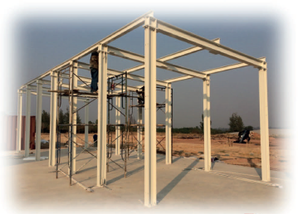
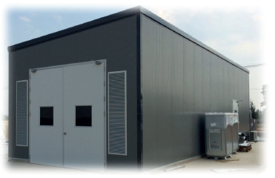
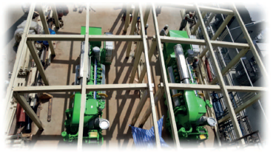
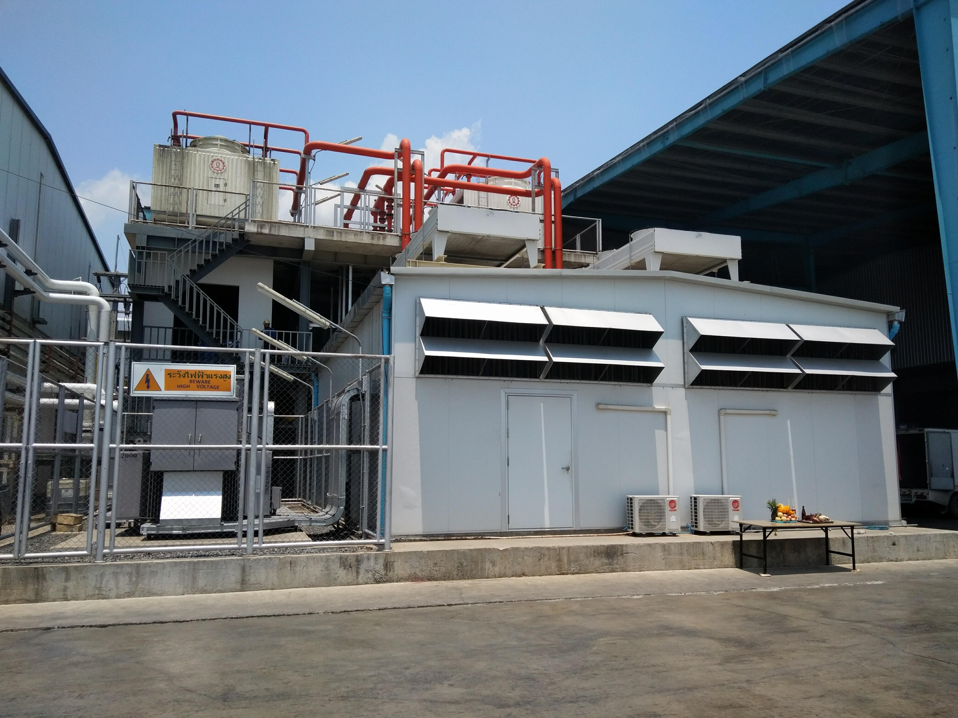



PowerBox-E
PowerBox-C

Slide 20

Municipal Solid Waste (MSW)
Retech Energy provides technology for the sepa­ration and sorting of Municipal Solid Waste.
Non-combustible and non-biodegradable materials such as glass and metals are removed during the sorting process and can be sold for recycling purposes.
The organic fraction (OFMSW) serves as an excellent feedstock for anaerobic digestion and the produced biogas will be utilized as a valuable fuel for heat and /or electricity generation.
RDF is a fraction of MSW and consists largely of combustible components such as plastics, paper, rubber, textiles, wood and other waste, and is suitable as a boiler fuel or combined with other fossil fuels such as coal.

Slide 21

MBR technology
Adding a filtration compartment to an activated sludge biological treatment
Enhancing effluent quality
Reducing total footprint of process
Increased treatment capacity

Slide 22
MBR technology versus conventional method
No log removal of bacteria
Tertiary
treatment
Reuse
Pretreatment
Conventional activated sludge reactor
Sedimentation tank
Log removal of bacteria
Pretreatment
Reuse
Tertiary
treatment
Reuse
Membrane bioreactor
Submerged filtration section

Slide 23






Exhibitions

Slide 24






Exhibitions

Slide 25






Oversea’s Site Trips with Clients

Slide 26


How to find us…
Retech Energy Co., Ltd.
2/22 Iyara Tower, 7th floor, Chan Rd. Soi 2, Thungwatdorn, Sathorn, Bangkok 10120
บริษัท รีเทค เอ็นเนอร์ยี่ จำกัด
2/22 อาคารไอยรา ชั้น 7, ถนนจันทน์ ซอย 2, แขวงทุ่งวัดดอน,
เขตสาทร, กรุงเทพฯ 10120
Tel. (โทร.) +66-2-6788921-2. Fax. (แฟ็กซ์) +66-2-678-8920
www.retech-energy.com contact@retech-energy.com

